Slide 1
Welcome To Grade 6 @HMS

Slide 2
Your Schedule for the day:
Now until 10:20 → stay in homeroom for introductions/expectations
10:20 – 10:30 (Recess) → Have a snack in the cafeteria, get a drink, go to the washroom, etc.
10:30 → head back to homeroom
10:35 → Period 3
11:30 → Wildcat 30 (Homeroom)
12:00 – 12:50 → eat lunch and hang out!
12:50 – 12:55 → Head to homeroom
12:55 - 1:50 → period 4
1:50 – 2:45 → period 5
2:45 → Load buses to go home

Slide 3
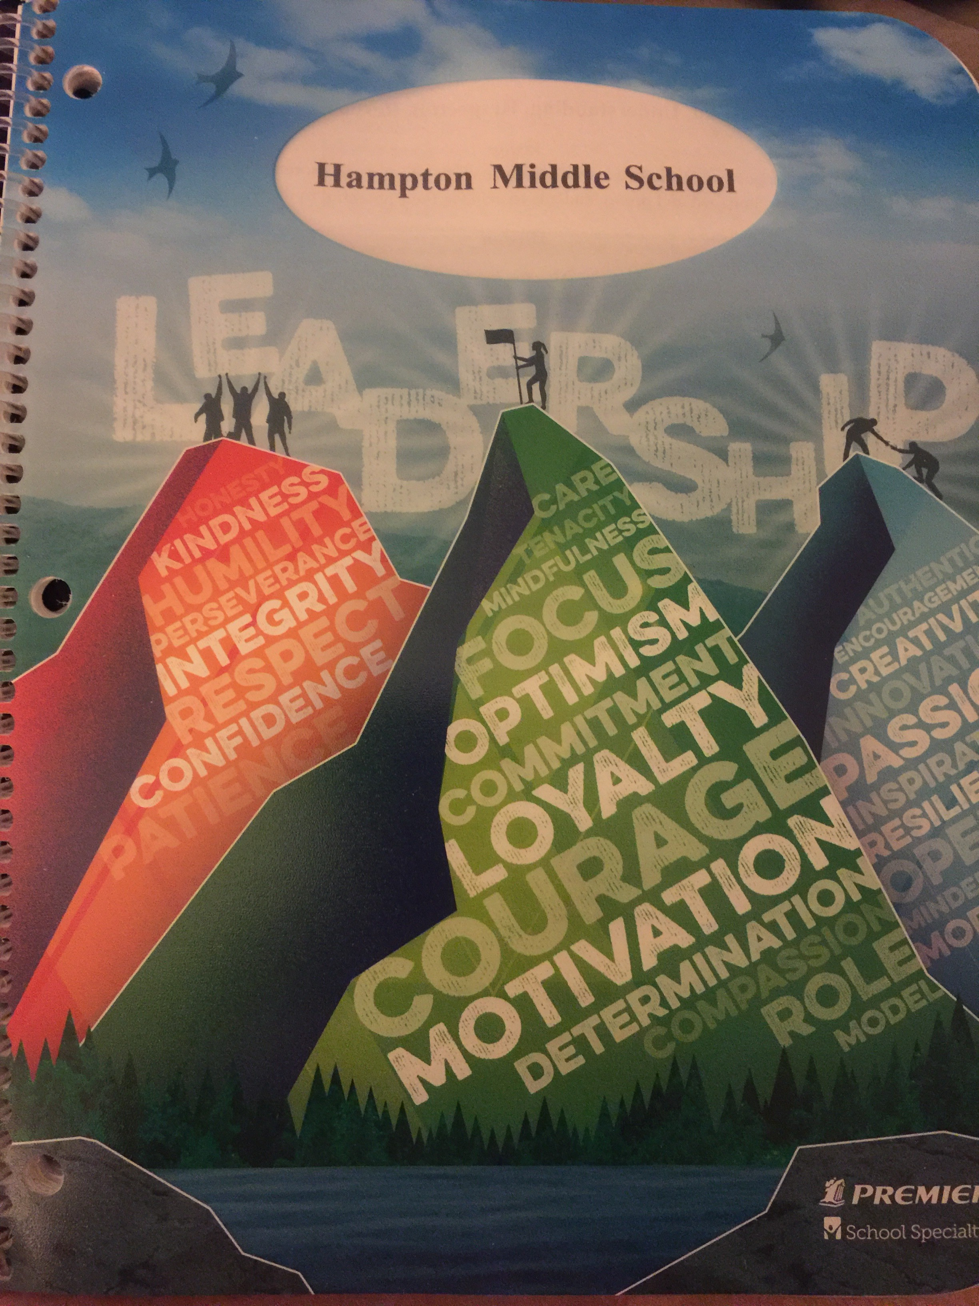
Agenda
Please print your first and last name as well as your homeroom class inside your agenda
There is also a spot for a copy of your schedule
Agendas are tools used as communication between home and school and reminders of upcoming assignments
They are to be signed every night by a parent/guardian

Slide 4
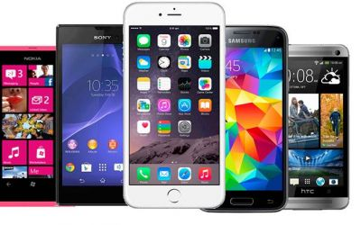
Electronic devices
These are best left at home or locked in your lockers
If you choose to bring your device to class, it must be placed in the “pockets” located within each classroom.
Make sure it is powered off or on silent mode
Devices are only to be used during recess and lunch; you may not use your device in the transition time between classes.

Slide 5
Recess 10:20 – 10:30
A Bell will ring at 10:20 to signal the start of recess break
You will have 10 minutes to go to the cafeteria and eat a snack
You should grab a quick drink or refill your water bottle and use the washroom
You are not allowed to eat or drink in the hallways
A bell will ring at 10:30 to let you know it’s time to finish up and head back to homeroom
Classes begin again at 10:35; for this week you will walk together as a class to period 3 with your homeroom teacher.

Slide 6
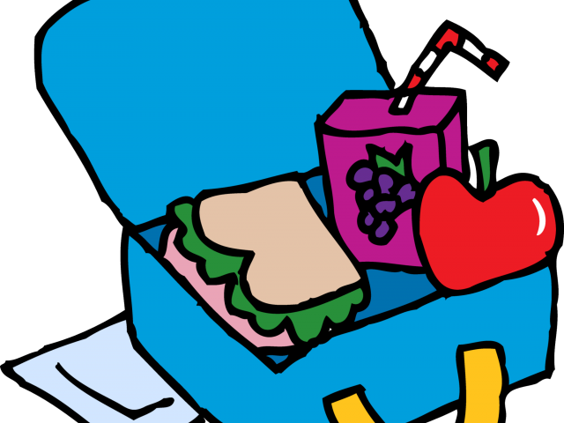
Lunch 12:00 – 12:50
A bell will ring at 12:00 to signal the beginning of the lunch hour
You can eat your lunch in the cafeteria or you can take it outside
If you’re planning on going outside, leave all of your school supplies inside
Make sure all of your garbage goes in the trash
For today, if you go outside you may only be in the front of the school – on the paved area or across on the lawn. The trees up near the road are your boundary line – do not go past these. Be careful crossing from the paved section to the lawn.
You may only exit out the main front door or out the cafeteria door. All other doors are emergency exits only.

Slide 7
Lunch 12:00 – 12:50
You may choose to stay in the cafeteria for the entire lunch break
At 12:20 you will hear a bell – this is a warning bell that in 5 minutes you must be either outside or in the cafeteria.
At 12:25 you will hear another bell – it is now half-way through lunch. You are not allowed to be in the hallways once this bell has rung.
At 12:50 you will hear the bell to end your lunch break.
If you are outside when this bell rings, line up in front of the grade 6 door (not on the stairs). A teacher or ea will let you inside and you are to head directly to your homeroom classroom.
If you are in the cafeteria when this bell goes, head to your homeroom classroom. For this week, You will head to your period 4 class altogether with your homeroom teacher leading the way.

Slide 8
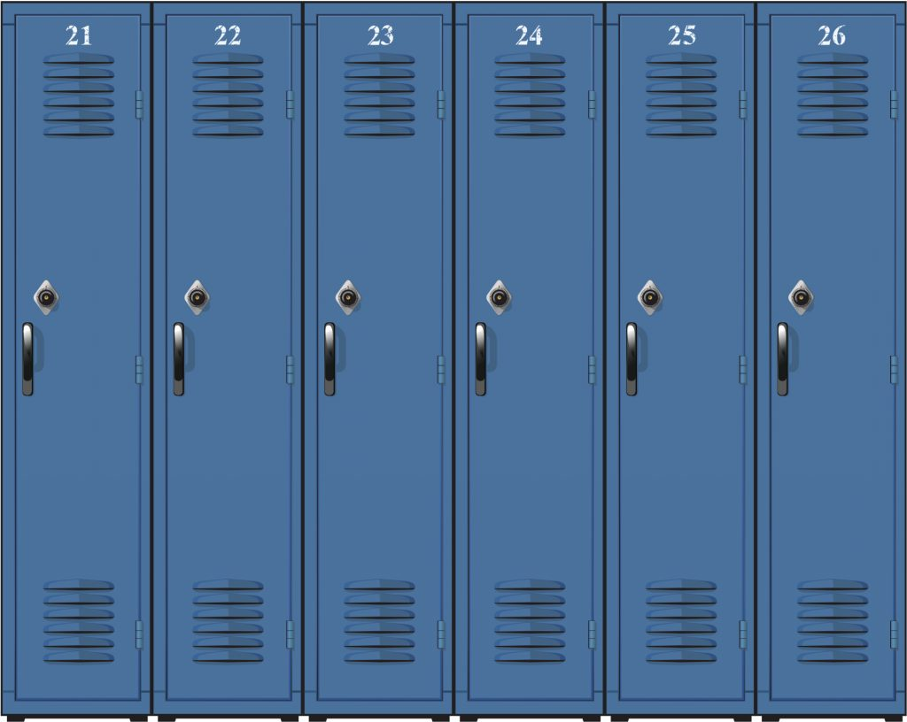
lockers
Each student will be assigned a locker to keep your personal belongings and school supplies in
This locker is to be kept neat and free of rotting food!!
It is extremely important that your locker always be locked with a school lock!
Do not sit pencils, pens, or other small items on the floor of the locker – they will disappear into a mysterious little crack and you will not be able to get them out
You should use magnets to hang items on your locker door

Slide 9
locks
Inside the box that your lock comes in is a piece of cardboard with the combination on it
There are 3 numbers in your combination
First, turn the dial clockwise (to the right) a few times around – we call this “cleaning it out”
Line up the “0” with the arrow

Slide 10
1st Number → turn right
Next, turn the dial in a clockwise direction (to the right) just until the 1st number of your combination lines up with the arrow at the top.

Slide 11
2nd Number → turn LEFt
Now turn the dial in a counter-clockwise direction (to the left) just until the 2nd number of your combination lines up with the arrow at the top.
Repeat this step again – turn the dial counterclockwise and stop on the 2nd number of your combination

Slide 12
3rd Number → turn right
Turn the dial clockwise (to the right) just until the 3rd and final number of your combination is lined up with the arrow at the top.
Try to open the lock.

Slide 13
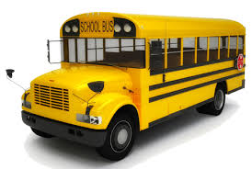
Pm Bus Assignments
Is there anyone who doesn’t know which bus to go on this afternoon??

